Slide 1


SMART DROP
202CS145 & DHARANIDHAR R P
202IT205 & ROHITH R V
202IT235 & SUJITH A
202IT255 & VASUDHAVAN
Under guidance of Dr.PRADEESH E L, HACKATHON LAB, BIT,
Sathy.

Slide 2
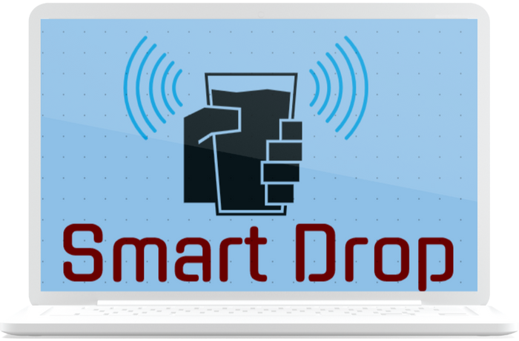
SMART DROP
SMART WATER CONSUMPTION MON ITORING

Slide 3
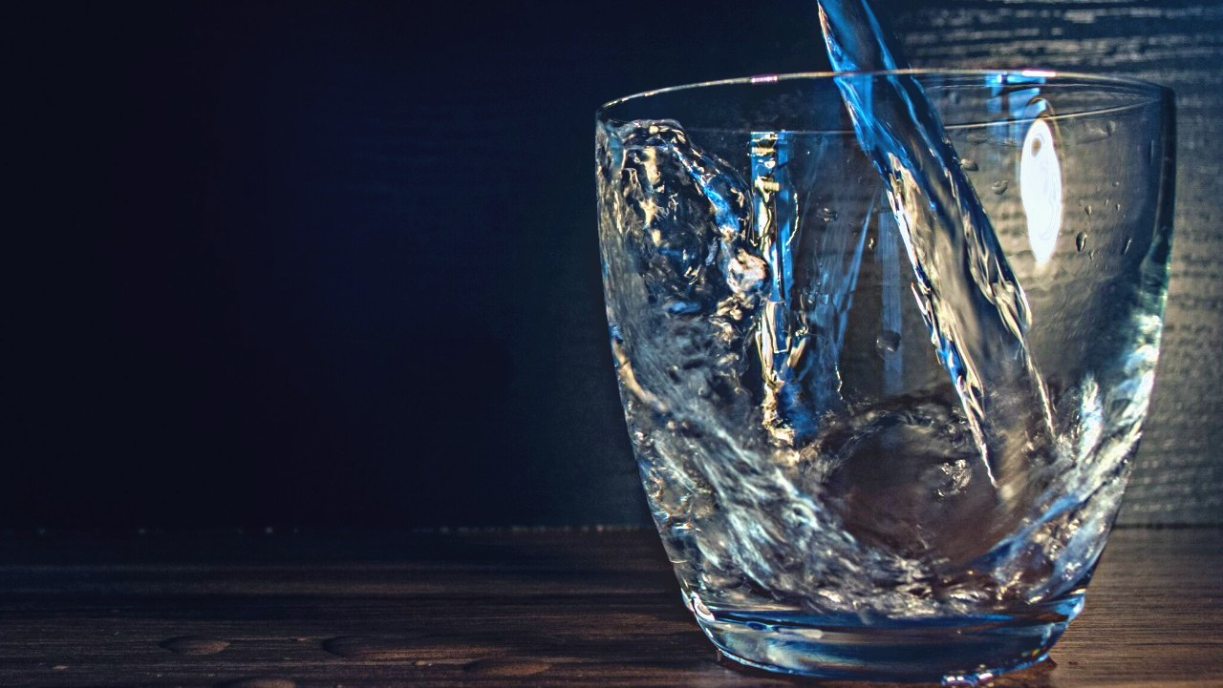
PROBLEM STATEMENT
SMART DROP
The statistics around the world recommend to intake 3.7 liters a day.
Even mild dehydration can reduce physical performance , leads to kidney failure, hypovolemic shock and even posses chance of shorter life span.
In order to overcome this an IoT based smart recognizing water dispenser system has been proposed.

Slide 4

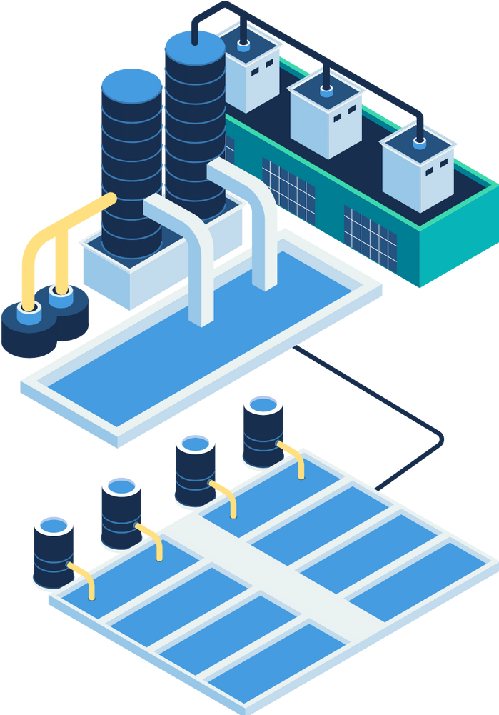
SOLUTION
SMART DROP
The proposed sensor integrated system automatically start/stops water discharge whenever the glass is scanned.
The dispensed water will be recorded along with the
individual face recognition.
-The data clusters are gathered in depolyed through cloud platform.
microcontroller and
The Data's can be monitored throughout the day on developed mobile application on regular basis to keep the user healthy.

Slide 5
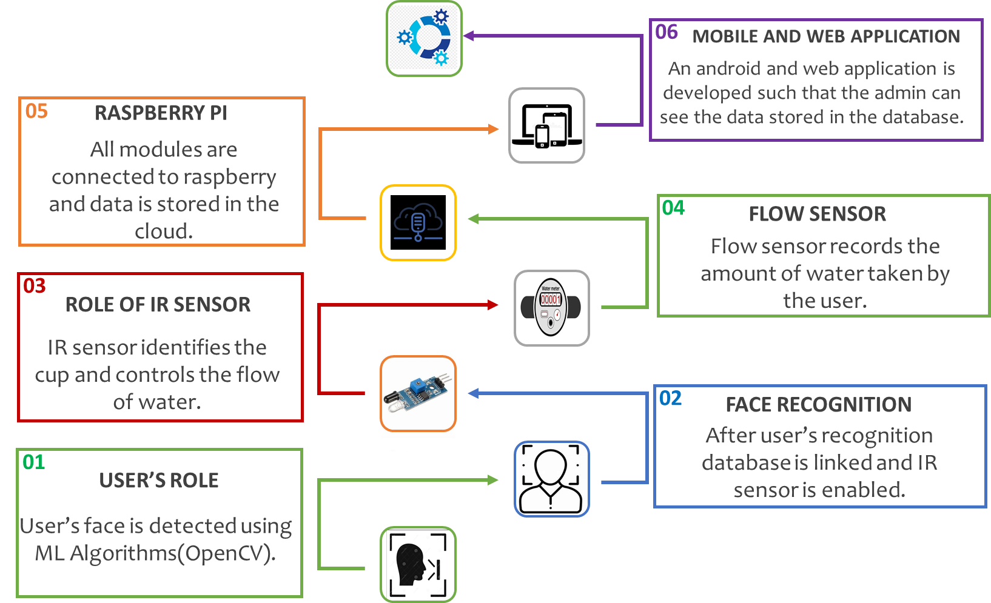
SMART DROP
PROPOSED METHODOLOGY

Slide 6
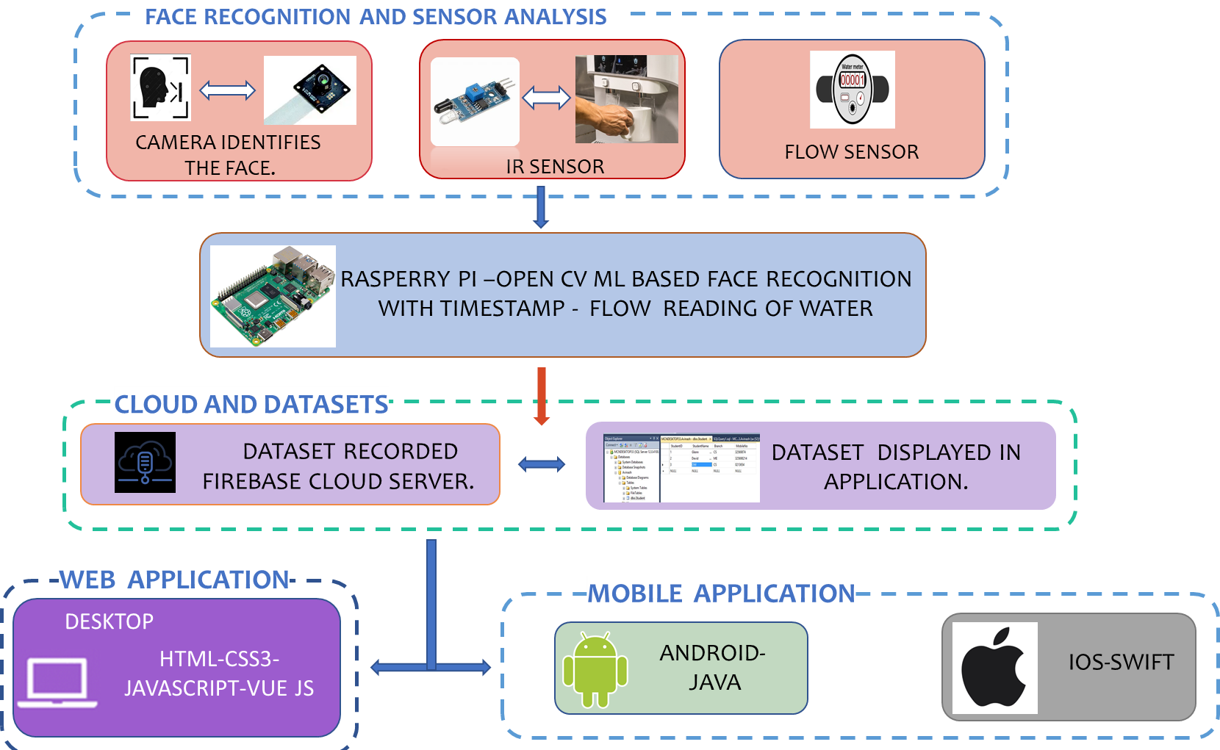
SMART DROP
TEHNOLOGY STACK

Slide 7
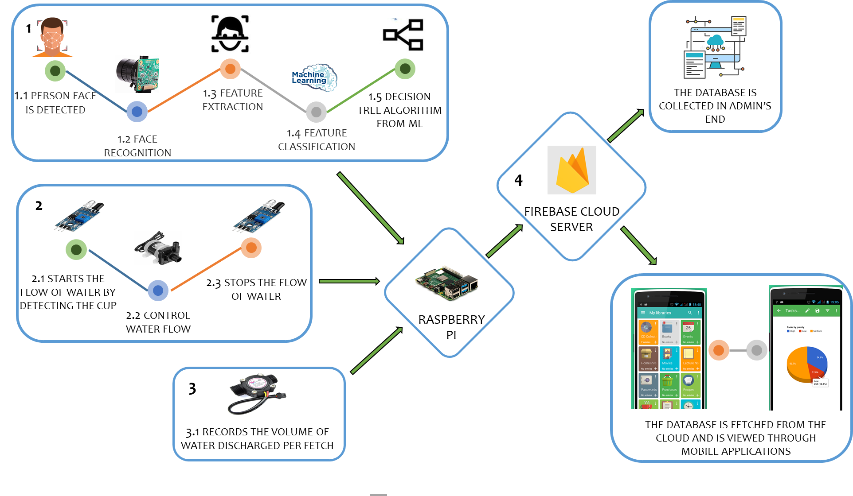
SMART DROP
USE CASE

Slide 8


SMART DROP
REVENUE MODEL
S.NO
1.
2.
3.
4.
5.
6.
NAME
IR Sensor HD Camera Flow sensor
Raspberry pi 4 Arduino
Water pump
Price (in Rupees)
40
1000
190
5000
500
55

Slide 9


Endures brain nourishment,reduces the risk of cancer.
SMART DROP
BENEFITS
Creates an self hydration awareness.
Makes free from Nephrological diseases.
malignant
Aids in performance.
maximizing the physical
Dispenses exact quantity of water required per fetch.

Slide 10

SMART DROP
SOCIAL IMPACTS
Perpetual monitoring of their body hydration.
Users could be protected from Cardiac- palpitations.
They get to live a happy long life.

